Slide 1
ORGANIZATIONAL BEHAVIOR

Slide 2
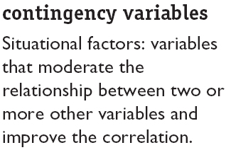
There Are Few Absolutes in OB
Contingency
Variables
x
y

Slide 3
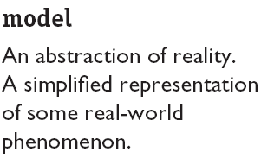
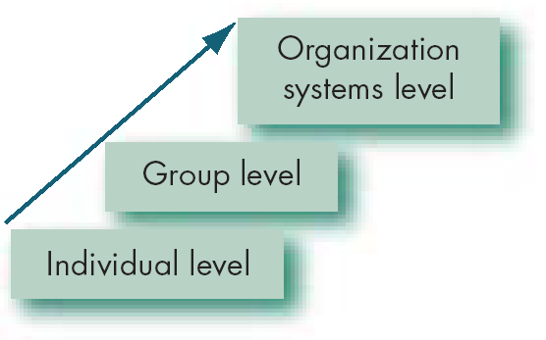
Basic OB Model, Stage I
Each Level is like a building block. Each level is constructed on the previous level.

Slide 4
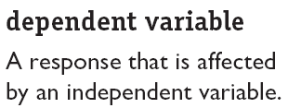
The Dependent Variables
y
x
Dependent variables in OB:
Productivity
Absenteeism
Turnover
Job satisfaction
Deviant workplace behaviour
Organisational citizenship behaviour

Slide 5
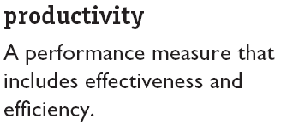


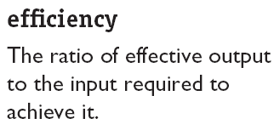
The Dependent Variables (cont’d)‏
An employees’ attitude and behaviour can affect productivity
Question: what factors will influence the effectiveness and efficiency of individuals?

Slide 6



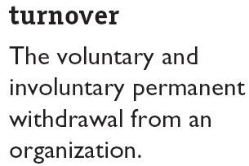
The Dependent Variables (cont’d)‏

Slide 7
The Dependent Variables (cont’d)‏
Deviant workplace behaviour
‘antisocial behaviour’ or ‘workplace incivility’
Loud music
Irritating co-workers
Insulting a colleague
Steal
Gossip excessively
Engage in sabotage
Result of DWB = chaotic workplace
Cause? Could be dissatisfaction

Slide 8
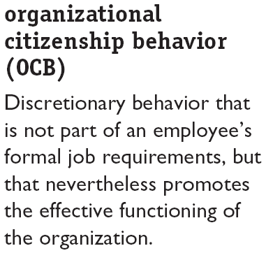

The Dependent Variables (cont’d)‏
Helping others, volunteer extra work, avoiding unnecessary conflicts, respecting the spirit and letter of rules and regulations, graciously tolerate work related nuisance

Slide 9
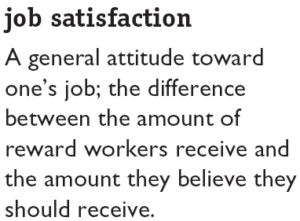

The Dependent Variables (cont’d)‏

Slide 10
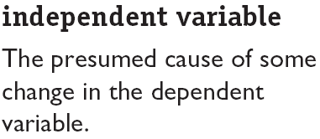
The Independent Variables
Independent
Variables
Individual-Level Variables
Group-Level
Variables
Organization
System-Level
Variables

Slide 11
Systems Level
HR policies & practice
Organisation structure & design
Organisational culture
Group Level
Group decision making
Leadership & trust
Conflict
Power & politics
Communication
Group structure
Individual Level
Biographical characteristics
Personality & emotions
Values and attitudes
Perception
Individual decision making
motivation
Productivity
Absenteeism
Turnover
Deviant work behaviour
Job satisfaction
Organisational citizenship behaviour

